Slide 1
Trends in Web Development
What you can expect to see trending in 2014
Houston Barnett

Slide 2
Grid Style Layouts
Skimmable but still coherent content
Best if built with this in mind from the start
Much more difficult to adapt later
Minimize white space
Utilize more of the page
Easy to read

Slide 3
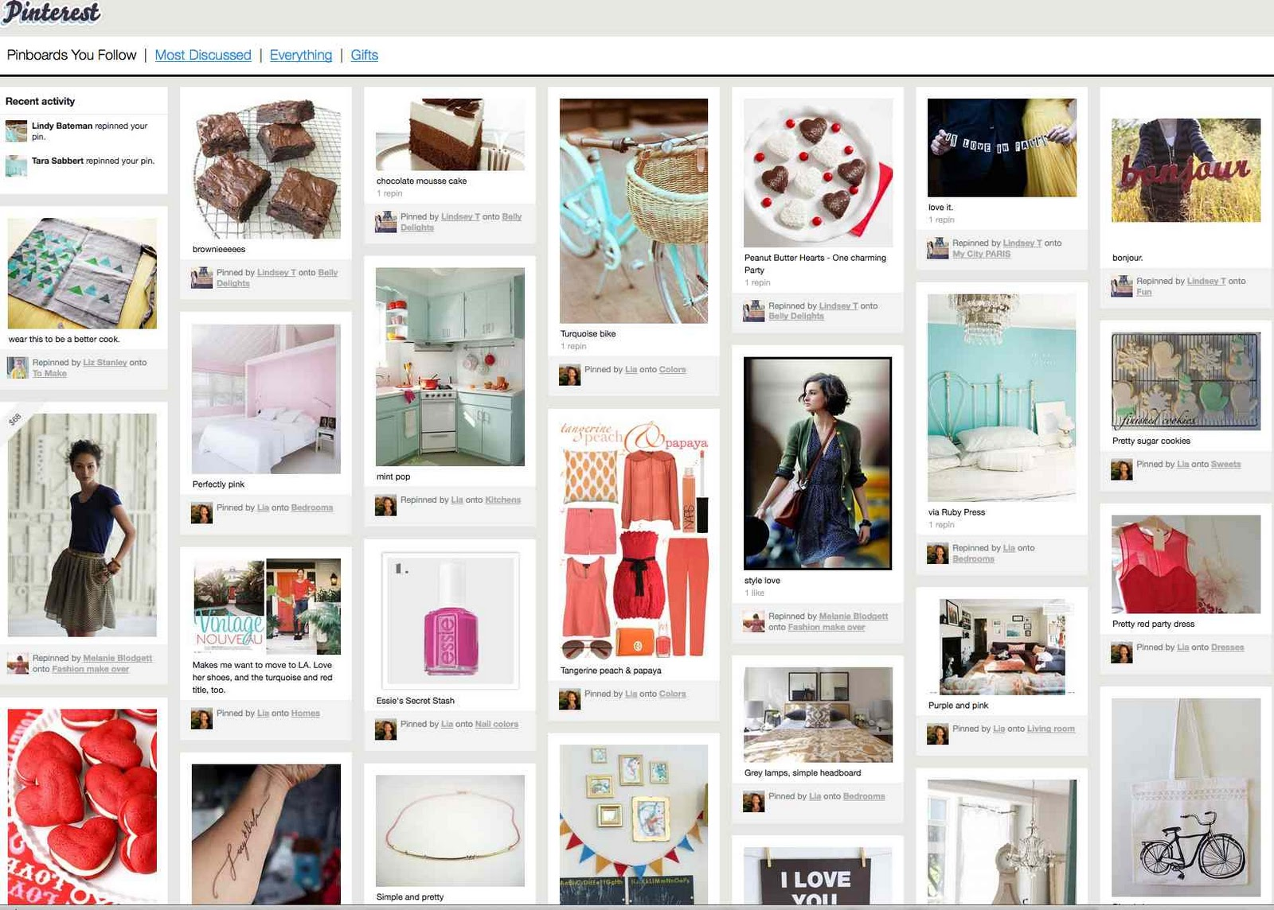
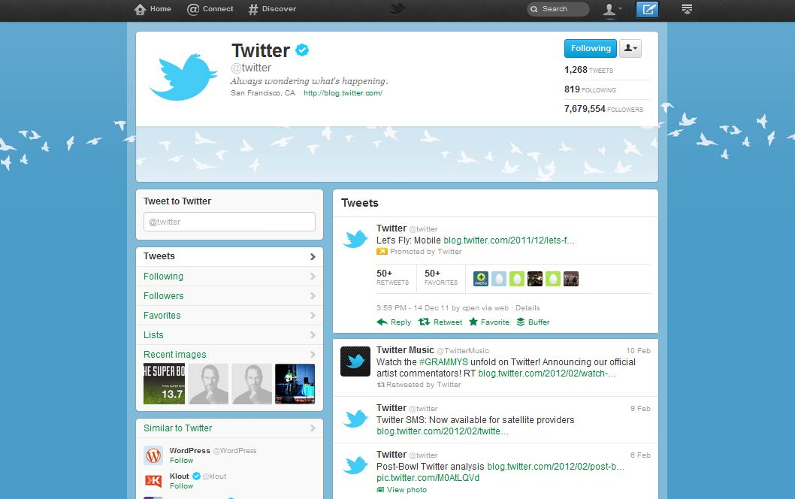
Grid Style Layouts
Some Key Technologies:
  Bootstrap
  Masonry JS
Pinterest
Twitter

Slide 4
Flat Design
Less Unnecessary Design Features
  shadows
  borders
  gradients
  patterns
Sleek, slim designs
Dropping any design element possible without taking away from the quality.

Slide 5
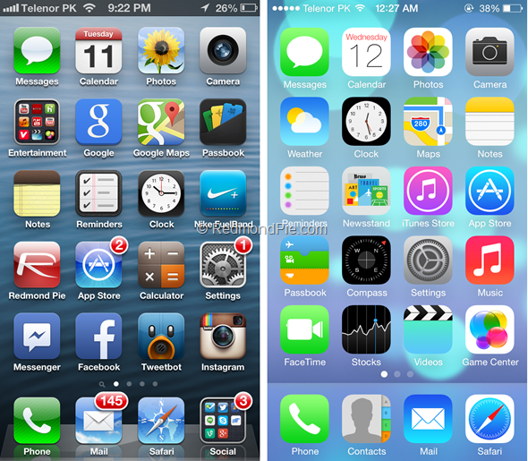
Flat Design
Key example: Apple (iPhone iOS7)
Old Design
Flat Design

Slide 6
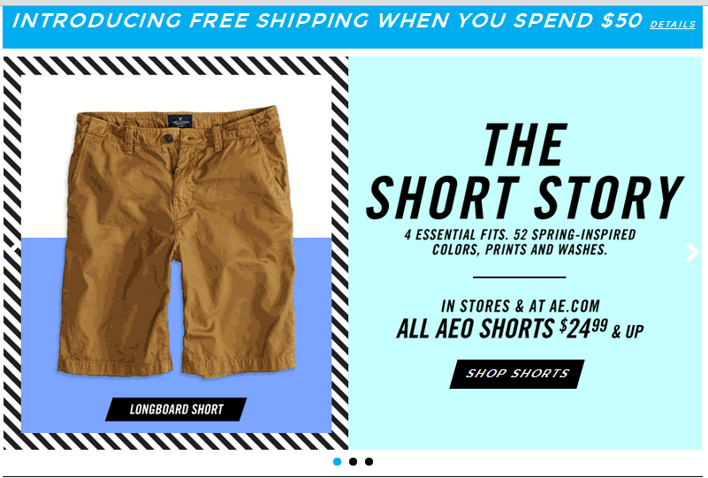
Hero Areas Replacing Sliders
Slider

Slide 7
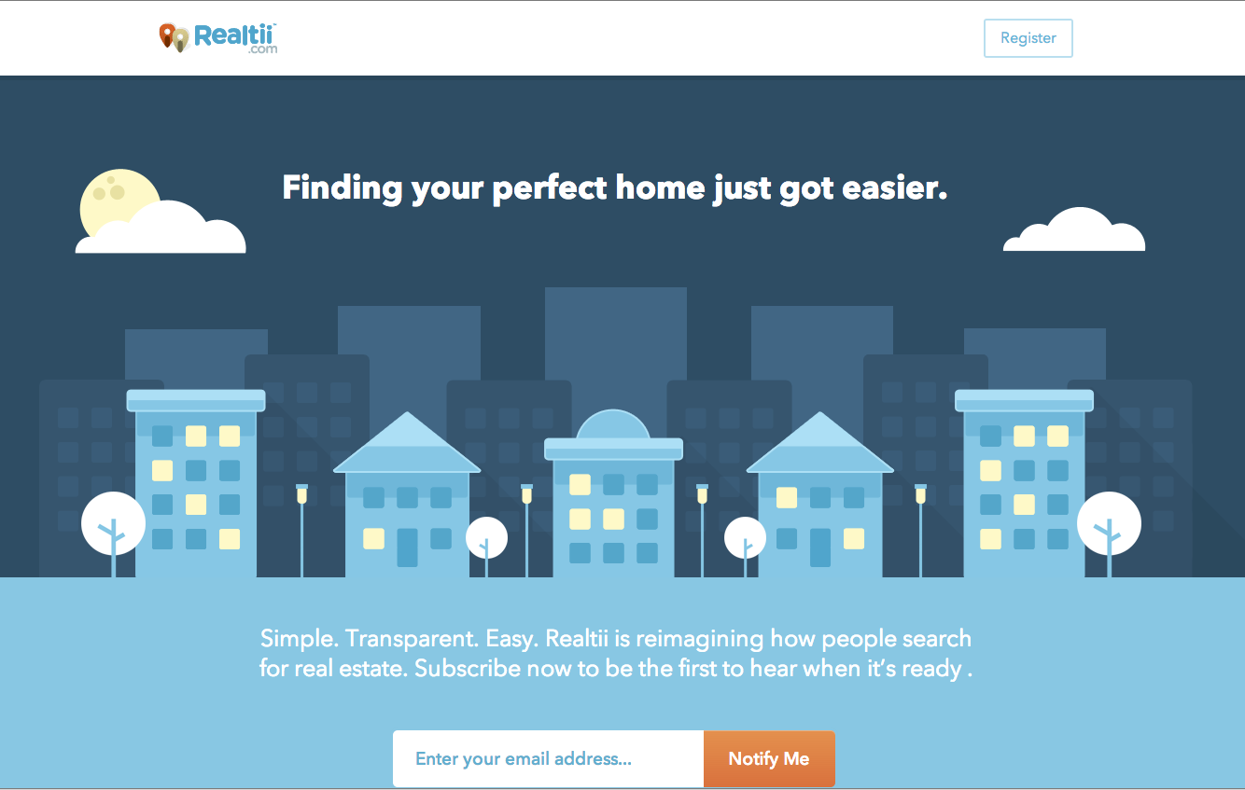
Hero Areas Replacing Sliders
Hero Area: a large area, usually on the intro page, with a design of some sort combined with small amount of text.
Hero Area

Slide 8
Mobile Emphasis
It has become equally important for websites to be accessible from both computers and mobile devices.
  Scrollable
  Resizable
  Vertical emphasis
  Social Media Integration
  *Grid design does wonders for mobile compatibility.

Slide 9
Infinitely Scrolling Sites
Aids with responsive design
  Mobile compatibility
  Alleviates need for horizontal scrolling.
Popular on many sites
  Twitter
  Facebook

Slide 10
Minimalist Color Schemes
Usually one hue, maybe 2
Allows for more emphasis when the shade or color changes
Better contrasting
Easy on the eyes

Slide 11
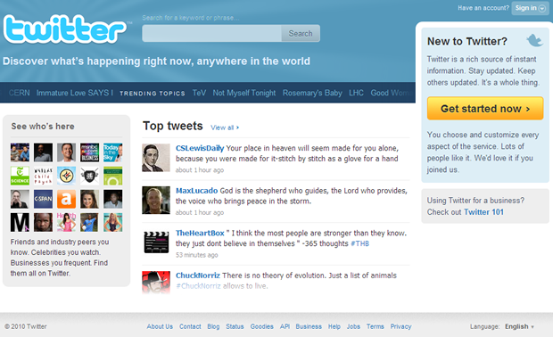
Minimalist Color Schemes
Blue is he only hue used, other than white space.
Notice how the yellow pops out as a result.

Slide 12
Dropping the Sidebar
Somewhat experimental at this point
Reduces the fight for your attention across the page
Easier responsive design
Adding a drop-menu at the top if necessary.
Expanding content down throughout the page.

Slide 13
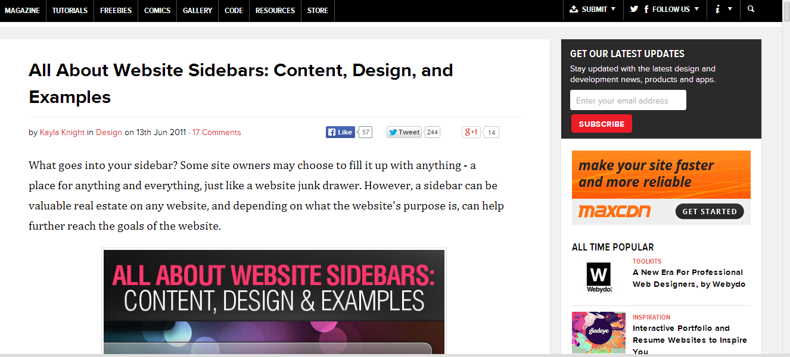
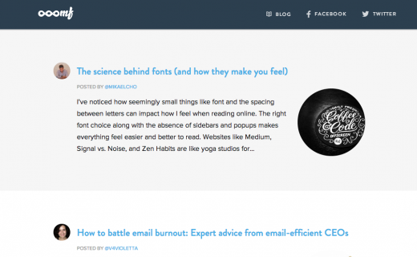
Dropping the Sidebar
Cluttered and possibly distracting.
Sleek and streamlined

Slide 14
3-D Transition Effects
Can take from the quality of the site.
Can slow down a page if overused.
However, if used tastefully, can achieve a very sophisticated feel to a web page.

Slide 15
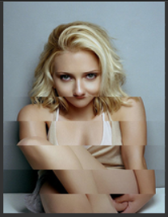
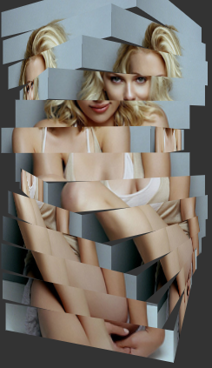
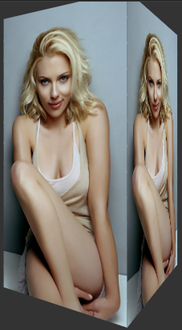
3-D Transition Effects
On page load:
Shutter effect
It settled after being dragged
Drag left or right

Slide 16
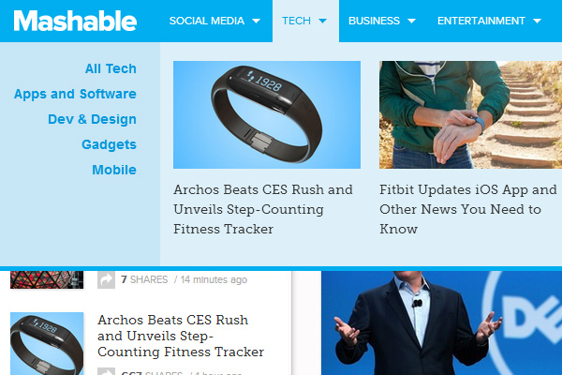
Mega-Navigation Menus
Menus that begin simple
Expand in to large amount of content
Very navigable
Good for magazines, clothing retailers, web forums

Slide 17
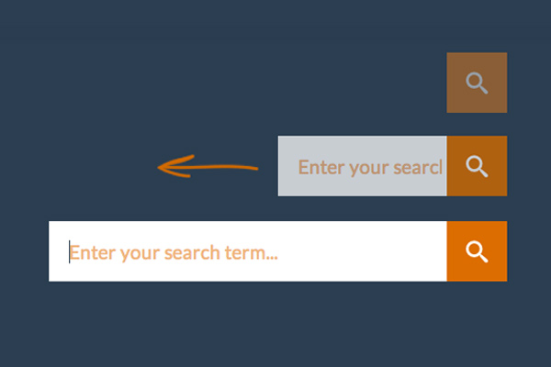
Expandable Search Bars
Begin as just a search icon
Click to expand and search
Saves room
Popular for responsive design

Slide 18
Mobile First Design
Trending is the concept of designing for mobile devices first.
Much easier to scale up to larger screens.
Developing for smaller devices forces you to consider what you need.
  Remove the unnecessary “fluff”
  More can be added as screen size increases.

Slide 19

Sources
http://thenextweb.com/dd/2013/12/29/10-web-design-trends-can-expect-see-2014/1/
http://www.hongkiat.com/blog/web-design-trends-2014/
http://blog.webafrica.co.za/wp-content/uploads/2014/03/Pinterest.jpg
http://www.mediabistro.com/alltwitter/files/2012/02/twitter-brand-page.jpg
http://cdn.redmondpie.com/wp-content/uploads/2013/06/home-screen.png
http://i.i.cbsi.com/cnwk.1d/i/tim//2010/03/31/twitter_home_page.png

